Slide 1
Project5
Virtual Memory
孔静、尚耔彤

Slide 2
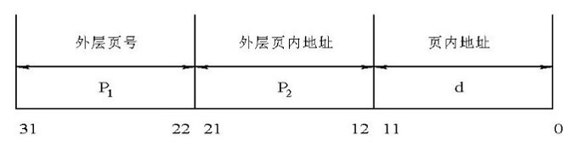
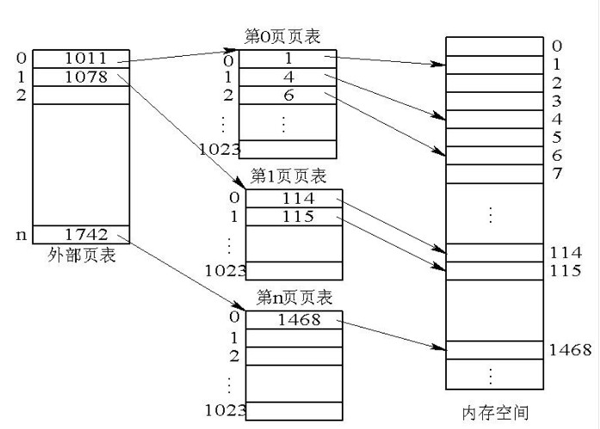
How are virtual addresses translated into physical addresses?
static uint32_t *kernel_pdir;(内核)
先利用外层页表寄存器
找到外层页表的地址
然后利用外层页号
找到外层页表
再利用外层页内地址
找到指定的页表项
最后拿页表的物理块号
与页内地址组合
构成内存物理地址
http://blog.csdn.net/ergouge/article/details/7460058

Slide 3
When are page faults triggered?
当所要找寻的地址，不在页表里的时候
即还没有映射到内存里时
发生页错误

Slide 4
How do you track all pages? What is the structure you use to track pages?
static page_map_entry_t page_map[PAGEABLE_PAGES];
typedef struct page_map_entry{
node_t node;
uint32_t vaddr;
uint32_t swap_loc;
bool_t is_pinned;
bool_t is_dirty;
bool_t is_available;
int pid;
uint32_t index;
uint32_t *page_dir;
} page_map_entry_t;
typedef struct node{
struct node *prev, *next;
} node_t;

Slide 5
What to do for setting up page directory and page table?
// address of the kernel page directory (shared by all kernel threads)
static uint32_t *kernel_pdir;
// allocate the kernel page tables
static uint32_t *kernel_ptabs[N_KERNEL_PTS];
void setup_page_table(pcb_t * p)
void init_ptab_entry(uint32_t * table, uint32_t vaddr, uint32_t paddr, uint32_t mode)
void insert_ptab_dir(uint32_t * dir, uint32_t *tab, uint32_t vaddr, uint32_t mode)
初始化
获得页目录
页表等信息
插入相应的
页目录页表中

Slide 6
What is the workflow of your page fault handler?
exception_14
先找寻有没有空的物理页
如果有，就分配该物理页
如果没有，就找到victim替换物理页
page_fault -> exception_14 -> current_running->fault_addr
-> page_fault_handler

Slide 7
How do you select the victim for allocating a new page when the physical RAM is limited?
如果是FIFO
最近被使用的物理页会在队尾
那么将队首（即距离上次使用最远的物理页）
替换
LRU
记录页表最近被使用次数，将次数最少的物理页替换出去。

Slide 8
THANKS

